Slide 1
Laplace Transform
Department of Mathematics
Anjuman college of Engineering and Technology

Slide 2
Definition of Laplace transforms
t is real, s is complex.

Slide 3
Evaluating F(s) = L{f(t)}
Example :
let
let
let

Slide 4
Property 1: Linearity
Example :
Proof :

Slide 5
Property 2: Change of Scale
Example :
Proof :
let

Slide 6
Property 3: First shifting
Example :
Proof :

Slide 7
Property 4: Multiplication by t^{n}
Example :
Proof :

Slide 8
Property 5: Derivatives
Example :
Proof :

Slide 9
Property 6: Integrals
Proof :
let
Example :

Slide 10
The Inverse Laplace Transform
The Department of Mathematics
Anjuman College of Engineering and Technology

Slide 11
To find the inverse Laplace transform we use transform pairs
along with partial fraction expansion:
F(s) can be written as;
Where P(s) & Q(s) are polynomials in the Laplace variable, s.
We assume the order of Q(s) P(s), in order to be in proper
form. If F(s) is not in proper form we use long division and
divide Q(s) into P(s) until we get a remaining ratio of polynomials
that are in proper form.

Slide 12
There are three cases to consider in doing the partial fraction expansion of F(s).
Case 1: F(s) has all non repeated roots.
Case 2: F(s) has all repeated roots.
Case 3: F(s) has irreducible quadratic factor.

Slide 13
Case 1: Example
Find A , B and C

Slide 14
Case 2:
Example

Slide 15
Case 3: Example

Slide 16
Convolution Theorem
Suppose F(s) = L{f (t)} and G(s) = L{g(t)} both exist for
s > a ≥ 0. Then H(s) = F(s)G(s) = L{h(t)} for s > a, where
The function h(t) is known as the convolution of f and g and the integrals above are known as convolution integrals.

Slide 17
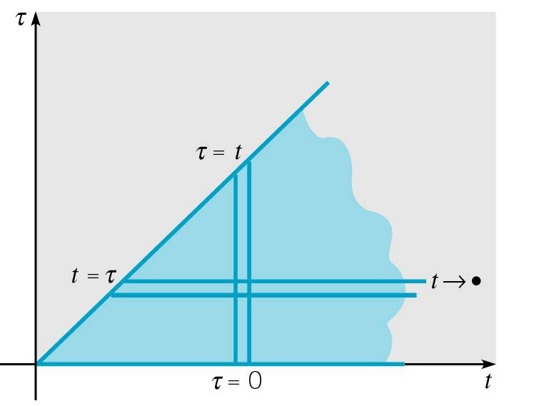
Proof

Slide 18
Example 2
Find the Laplace Transform of the function h given below.
Solution: Note that f (t) = t and g(t) = sin2t, with
Thus by Convolution Theorem,

Slide 19
Example 3: Find Inverse Transform (1 of 2)
Find the inverse Laplace Transform of H(s), given below.
Solution: Let F(s) = 2/s² and G(s) = 1/(s - 2), with
Thus by Convolution Theorem,

Slide 20
Example 3: Solution h(t) (2 of 2)
We can integrate to simplify h(t), as follows.

Slide 21
Example 4: Initial Value Problem
Find the solution to the initial value problem

Slide 22
We have

